Slide 1

what happens after learning?
Prediction Serving
Joseph E. Gonzalez
Asst. Professor, UC Berkeley
jegonzal@cs.berkeley.edu
Co-founder, Dato Inc.
joseph@dato.com

Slide 2
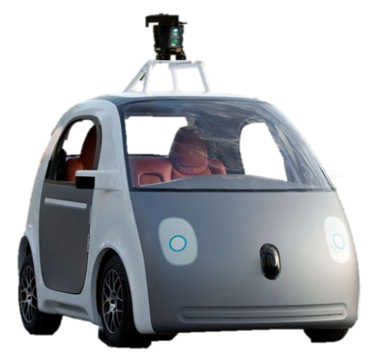



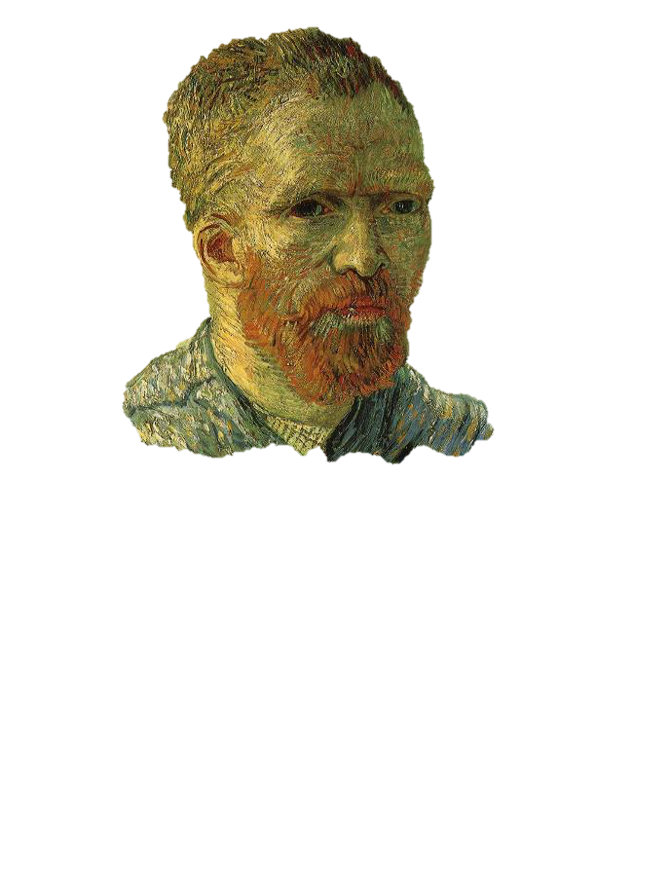





Outline
VELOX
Clipper
Caffe
VW
Create
Daniel Crankshaw, Xin Wang
Michael Franklin, & Ion Stoica

Slide 3
Learning
Big
Data
Training
Big Model
Timescale: minutes to days
Systems: offline and batch optimized
Heavily studied ... major focus of the AMPLab

Slide 4
Learning
Inference
Big
Data
Query
Training
?
Decision
Big Model
Application

Slide 5
Inference
Learning
Query
Big
Data
Training
Decision
Big Model
Application
Timescale: ~10 milliseconds
Systems: online and latency optimized
Less studied …

Slide 6
Learning
Inference
Big
Data
Query
Training
Decision
Big Model
Application
Feedback

Slide 7
Learning
Inference
Training
Decision
Big
Data
Timescale: hours to weeks
Systems: combination of systems
Less studied …
Application
Feedback

Slide 8
Learning
Inference
Big
Data
Query
Training
Responsive
(~10ms)
Adaptive
(~1 seconds)
Decision
Big Model
Application
Feedback

Slide 9
VELOX Model Serving System [CIDR’15]
Daniel Crankshaw, Peter Bailis, Haoyuan Li, Zhao Zhang, Joseph Gonzalez, Michael J. Franklin, Ali Ghodsi, and Michael I. Jordan
Responsive
(~10ms)
Adaptive
(~1 seconds)
Key Insight: Decompose models into fast and slow changing components

Slide 10
Learning
Inference
Big
Data
Query
Training
Decision
Application
Feedback

Slide 11
Learning
Inference
Slow Changing
Model
Fast Changing Model
Big
Data
Query
Feedback
Training
Fast
Decision
Application
Feedback
Slow

Slide 12
Hybrid Offline + Online Learning
Update feature functions offline using batch solvers
Leverage high-throughput systems (Tensor Flow)
Exploit slow change in population statistics
Update the user weights online:
Simple to train + more robust model
Address rapidly changing user statistics

Slide 13
Common modeling structure
Matrix Factorization
Deep Learning
Ensemble
Methods
Items
Users
Ratings
Input

Slide 14
Learning
Inference
Slow Changing
Model
Fast Changing Model
Big
Data
Query
Feedback
Training
Fast
Decision
Application
Feedback
Slow

Slide 15
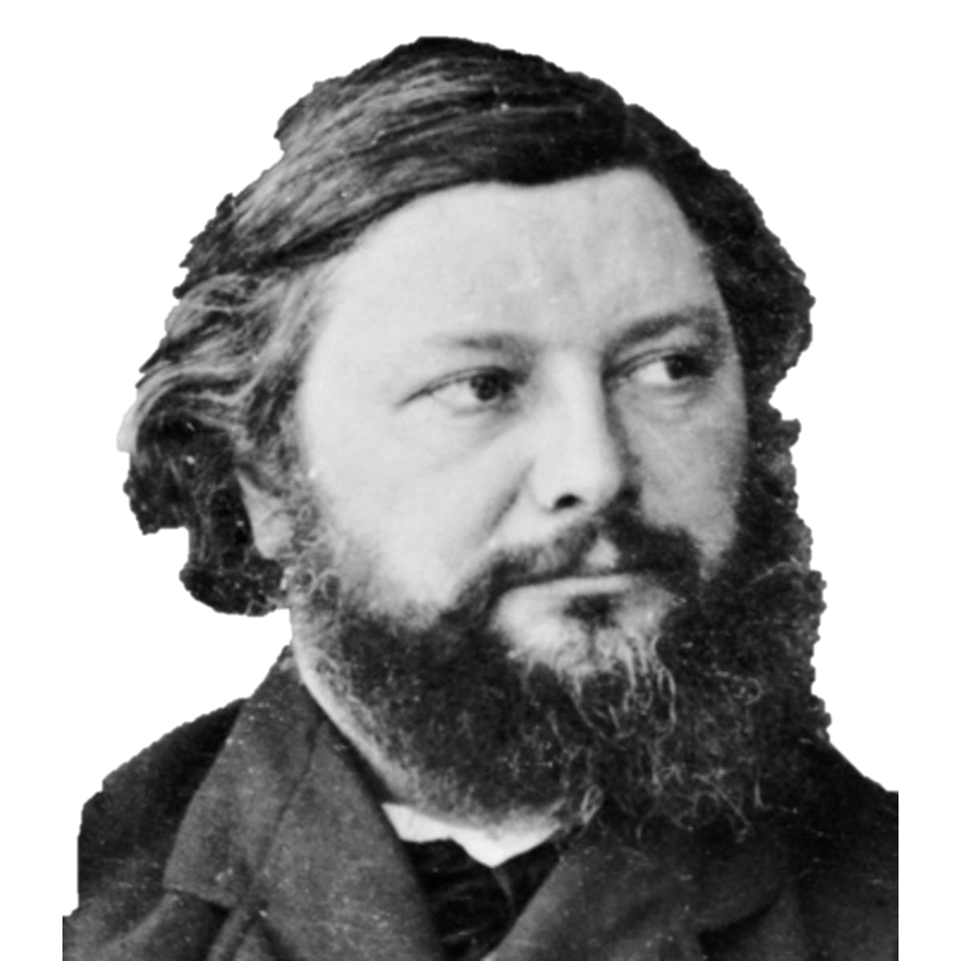
Fast Changing Model
Learning
per user
Inference
Slow Changing
Model
Big
Data
Query
Feedback
Training
Fast
Decision
Application
Feedback
Slow

Slide 16
Velox Online Learning for Recommendations (20-News Groups)
Online Updates: 0.4 ms
Retraining: 7.1 seconds
Fast Updates + Weak Features
>4 orders-of-magnitude faster adaptation
given sufficient offline training data
Error
Fast Updates Only
Full Updates
Examples

Slide 17
Velox Online Learning for Recommendations (20-News Groups)
Partial Updates: 0.4 ms
Retraining: 7.1 seconds
>4 orders-of-magnitude faster adaptation
Error
Partial Updates
Full Updates
Examples

Slide 18
Fast Changing Model
Learning
per user
Inference
Slow Changing
Model
Big
Data
Query
Feedback
Training
Fast
Decision
Application
Feedback
Slow

Slide 19
Learning
Fast Changing Model
Inference
Slow Changing
Model
per user
Big
Data
Query
Training
Feedback
Decision
Fast
Velox
Application
Feedback
Slow

Slide 20
VELOX: the Missing Piece of BDAS
Learning
Spark Streaming
BlinkDB
Graph
Frames
Keystone
ML
B
erkeley
ata
nalytics
tack
Spark SQL
GraphX
MLLib
D
Spark
A
Mesos
S
Tachyon
HDFS, S3, …

Slide 21
VELOX: the Missing Piece of BDAS
Management
and Serving
Learning
Spark Streaming
BlinkDB
Graph
Frames
Keystone
ML
B
erkeley
ata
nalytics
tack
Velox
Spark SQL
GraphX
MLLib
D
Spark
A
Mesos
S
Tachyon
HDFS, S3, …

Slide 22
VELOX: the Missing Piece of BDAS
Management
and Serving
Learning
Spark Streaming
BlinkDB
Graph
Frames
Keystone ML
B
erkeley
ata
nalytics
tack
Velox
Spark SQL
GraphX
MLLib
D
Spark
A
Mesos
S
Tachyon
HDFS, S3, …

Slide 23
VELOX Architecture
Fraud Detection
Content
Rec.
Keystone ML
Velox
MLLib
Spark
Single JVM Instance

Slide 24
VELOX Architecture
Fraud Detection
Content
Rec.
Personal
Asst.
Robotic
Control
Machine
Translation
Keystone ML
Velox
VW
MLLib
Spark
Single JVM Instance
Create
Caffe

Slide 25
VELOX as a Middle Layer Arch?
Fraud Detection
Content
Rec.
Personal
Asst.
Robotic
Control
Machine
Translation
Generalize ?
Velox
VW
Create
Keystone ML
Spark
MLLib
Caffe

Slide 26

A Low-Latency Online Prediction Serving System
Clipper
Daniel Crankshaw
Xin Wang
Michael Franklin
Joseph E. Gonzalez
Ion Stoica

Slide 27
Clipper Generalizes Velox Across ML Frameworks
Fraud Detection
Content
Rec.
Personal
Asst.
Robotic
Control
Machine
Translation
Clipper
VW
Create
Caffe

Slide 28
Clipper
Caffe
VW
Key Insight: The challenges of prediction serving can be addressed between end-user applications and machine learning frameworks
Create
As a result, Clipper is able to:
hide complexity
by providing a common prediction interface
bound latency and maximize throughput
through approximate caching and adaptive batching
enable robust online learning and personalization
through generalized split-model correction policies
without modifying machine learning frameworks or end-user applications
Notes:
By interposing between applications and ML frameworks we we can reduce complexity and latency, improve throughput, and enable generic online learning and personalization

Slide 29
Clipper Design Goals
Low and bounded latency predictions
interactive applications need reliable latency objectives
Up-to-date and personalized predictions across models and frameworks
generalize the split model decomposition
Optimize throughput for performance under heavy load
single query can trigger many predictions
Simplify deployment
serve models using the original code and systems

Slide 30
Clipper Architecture
Fraud Detection
Content
Rec.
Personal
Asst.
Robotic
Control
Machine
Translation
Clipper
VW
Create
Caffe

Slide 31
Clipper Architecture
Applications
Predict
RPC/REST Interface
Observe
Clipper
VW
Create
Caffe

Slide 32
Clipper Architecture
Applications
Predict
RPC/REST Interface
Observe
Clipper
ust
RPC
RPC
RPC
RPC
Model Wrapper (MW)
MW
MW
MW
Caffe
VW
Create

Slide 33
Clipper Architecture
Applications
Predict
RPC/REST Interface
Observe
Clipper
Improve accuracy through ensembles, online learning and personalization
Correction Layer
Model Abstraction Layer
Provide a common interface to models
while bounding latency and maximizing throughput.
RPC
RPC
RPC
RPC
Model Wrapper (MW)
MW
MW
MW
Caffe

Slide 34
Clipper Architecture
Applications
Predict
RPC/REST Interface
Observe
Clipper
Correction Layer
Correction Policy
Model Abstraction Layer
Approximate Caching
Adaptive Batching
RPC
RPC
RPC
RPC
Model Wrapper (MW)
MW
MW
MW
Caffe

Slide 35
Applications
Predict
RPC/REST Interface
Observe
Clipper
Correction Layer
Correction Policy
Model Abstraction Layer
Approximate Caching
Approximate Caching
Adaptive Batching
Adaptive Batching
RPC
RPC
RPC
RPC
Model Wrapper (MW)
Model Wrapper (MW)
MW
MW
MW
MW
MW
MW
Caffe
Provides a unified generic prediction API across frameworks
Reduce Latency → Approximate Caching
Increase Throughput → Adaptive Batching
Simplify Deployment → RPC + Model Wrapper

Slide 36
Applications
Predict
RPC/REST Interface
Observe
Clipper
Correction Layer
Correction Policy
Model Abstraction Layer
Approximate Caching
Adaptive Batching
RPC
RPC
RPC
RPC
Model Wrapper (MW)
MW
MW
MW
Caffe
Provide a common interface to models while bounding latency and maximizing throughput.

Slide 37
Clipper
Correction Layer
Correction Policy
Model Abstraction Layer
Approximate Caching
Adaptive Batching
RPC
RPC
RPC
RPC
Model Wrapper (MW)
MW
MW
MW
Caffe
Common Interface → Simplifies Deployment:
Evaluate models using original code & systems
Models run in separate processes
Resource isolation

Slide 38
Clipper
Correction Layer
Correction Policy
Model Abstraction Layer
Approximate Caching
Adaptive Batching
RPC
RPC
RPC
RPC
RPC
RPC
Model Wrapper (MW)
MW
MW
MW
MW
MW
Caffe
Common Interface → Simplifies Deployment:
Evaluate models using original code & systems
Models run in separate processes
Resource isolation
Scale-out
Problem: frameworks optimized for batch processing not latency

Slide 39
Adaptive Batching to Improve Throughput
Why batching helps:
Optimal batch depends on:
hardware configuration
model and framework
system load
Clipper Solution:
be as slow as allowed…
Inc. batch size until the latency objective is exceeded (Additive Increase)
If latency exceeds SLO cut batch size by a fraction (Multiplicative Decrease)
A single
page load may generate
many queries
Hardware
Acceleration
Helps amortize
system overhead

Slide 40
Tensor Flow Conv. Net (GPU)
Optimal Batch Size
Throughput
Latency (ms)
P99 Latency
Throughput (Queries Per Second)
Latency
Deadline
Avg. Latency
Batch Sizes (Queries)

Slide 41
Comparison to TensorFlow Serving
Takeaway: Clipper is able to match the average latency of TensorFlow Serving while reducing tail latency (2x) and improving throughput (2x)
Notes:
to get a sense to how we perform, we compared to google’s tensor flow serving
use same code as google, expect to get similar performance
see similar latencies, but clipper is able to ensure a more consistent latency
now if we look at throughput, see substantial improvement in throughput, more adaptive

Slide 42
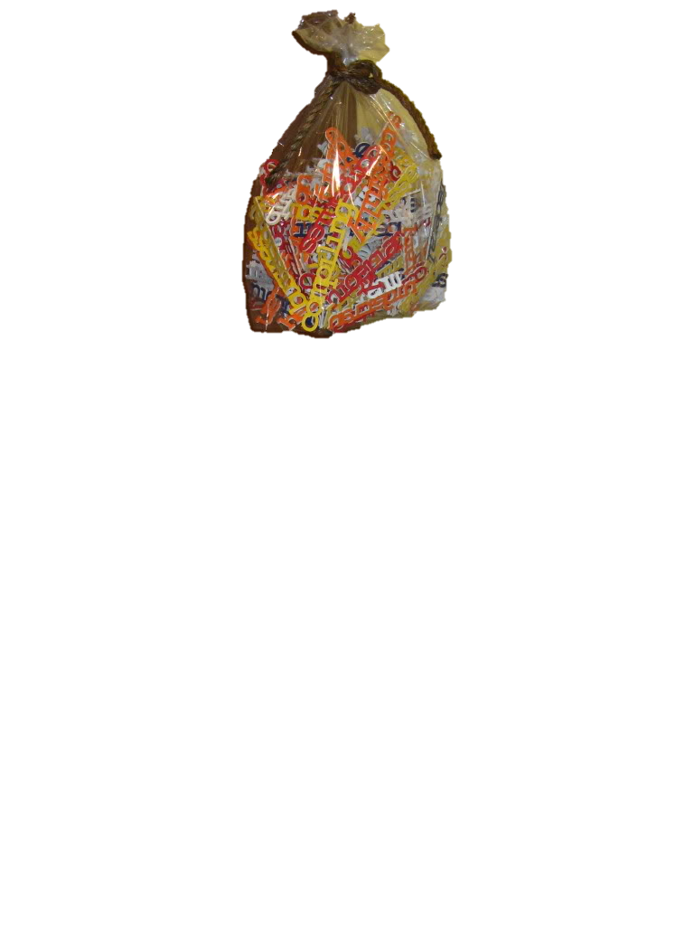
Approximate Caching to Reduce Latency
Opportunity for caching
Need for approximation
Clipper Solution: Approximate Caching
apply locality sensitive hash functions
Popular items may be evaluated frequently
Cache Hit
Hash 1
?
Hash 2
Cache Miss
Bag-of-Words
Model
?
Images
Cache Hit
?
Error
High Dimensional and continuous valued queries have low cache hit rate.

Slide 43
Clipper Architecture
Applications
Predict
RPC/REST Interface
Observe
Clipper
Correction Layer
Correction Policy
Model Abstraction Layer
Approximate Caching
Adaptive Batching
RPC
RPC
RPC
RPC
Model Wrapper (MW)
MW
MW
MW
Caffe

Slide 44
Applications
Predict
RPC/REST Interface
Observe
Clipper
Correction Layer
Correction Policy
Goal:
Maximize accuracy through ensembles, online learning, and personalization
Generalize the split-model insight from Velox to achieve:
robust predictions by combining multiple models & frameworks
online learning and personalization by correcting and personalizing predictions in response to feedback

Slide 45
Learning
Inference
Velox
Big
Data
Slow Changing
Model
Fast Changing User Model
Feedback
Fast
Application
Feedback
Slow

Slide 46
Learning
Inference
Slow Changing
Model
Clipper
Fast Changing User Model
Big
Data
Feedback
Fast
Caffe
Application
Feedback
Slow

Slide 47
Correction Policy
Slow Changing
Model
Improves prediction accuaray by:
Incorporating real-time feedback
Managing personalization
Combine models & frameworks
enables frameworks to compete
Clipper
Fast Changing User Model
Caffe

Slide 48
Improved Prediction Accuracy (ImageNet)
System | Model | Error Rate | #Errors
Caffe | VGG | 13.05% | 6525
Caffe | LeNet | 11.52% | 5760
Caffe | ResNet | 9.02% | 4512
TensorFlow | Inception v3 | 6.18% | 3088
sequence of pre-trained state-of-the-art models
Notes:
ImageNet public validation dataset (50K examples)

Slide 49
Improved Prediction Accuracy
System | Model | Error Rate | #Errors
Caffe | VGG | 13.05% | 6525
Caffe | LeNet | 11.52% | 5760
Caffe | ResNet | 9.02% | 4512
TensorFlow | Inception v3 | 6.18% | 3088
Clipper | Ensemble | 5.86% | 2930
5.2% relative improvement in prediction accuracy!
Notes:
ImageNet public validation dataset (50K examples)

Slide 50
Cost of Ensembles
Increased Load
Solutions:
Caching and Batching
Load-shedding correction policy can prioritize frameworks
Stragglers
e.g., framework fails to meet SLO
Solution: Anytime predictions
Correction policy must render predictions with missing inputs
e.g., built-in correction policies substitute expected value
Slow Changing
Model
Clipper
Fast Changing User Model
?
Caffe
Notes:
Skip to 48 if needed

Slide 51
Evaluation of Throughput Under Heavy Load
Accuracy
Throughput (queries per second)
Takeaway: Clipper is able to gracefully degrade accuracy to maintain availability under heavy load.
Notes:
Experiments on digits using Spark SVMs

Slide 52
Conclusion
Clipper sits between applications and ML frameworks to
to simplifying deployment
bound latency and increase throughput
and enable real-time learning and personalization
across machine learning frameworks
Clipper
Caffe
VW
Create

Slide 53
Big
Data
Query
Training
Decision
Model
Application
Feedback
VELOX
Clipper
Caffe
VW
Create

Slide 54
Ongoing & Future Research Directions
Serving and updating RL models
Bandit techniques in correction policies
Splitting inference across the cloud and the client to reduce latency and bandwidth requirements
Secure model evaluation on the client (model DRM)

Slide 55
Coarsening + Anytime Predictions
Coarser Hash
More Features
Approx. Expectation
Overly Coarsened
Best
No Coarsening
Better

